Slide 1

CSE 5330
Course and Project Experience
Team 6 <1002030416, 1001964976, 1002014523, 1001946768>
<Veda Samhitha Manne,
Usha Chandana Reddy Parne ,
Sai Raghu Ram Dontireddy,
Aknith Reddy Mekala >

Slide 2
TITLE
Doctor Appointment Booking:
It is the online booking platform to schedule the appointment with the doctor(In-person).
In the real world it is used to automate the manual system, like:
Appointment Scheduling
Multiple-Location
Patient Records Management
Doctor Management
Pharmacy and Lab availability

Slide 3

Project Overview
The patient will go to the site
Search for the doctor based on his requirement
Choose a doctor and schedule the appointment
Expect your turn.
Based on the consultation doctor prescribes either medicine or tests to the patient.
Patient is directed according to the prescription.
Medicine pickup process.

Slide 4
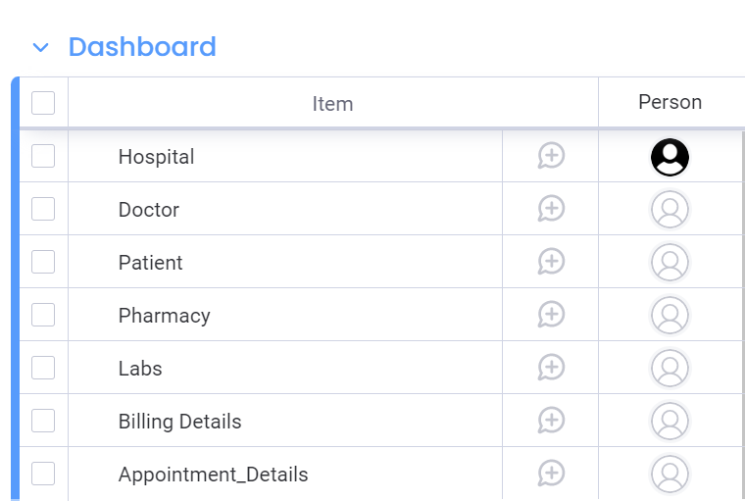
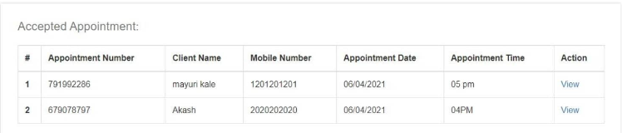
Project Overview

Slide 5
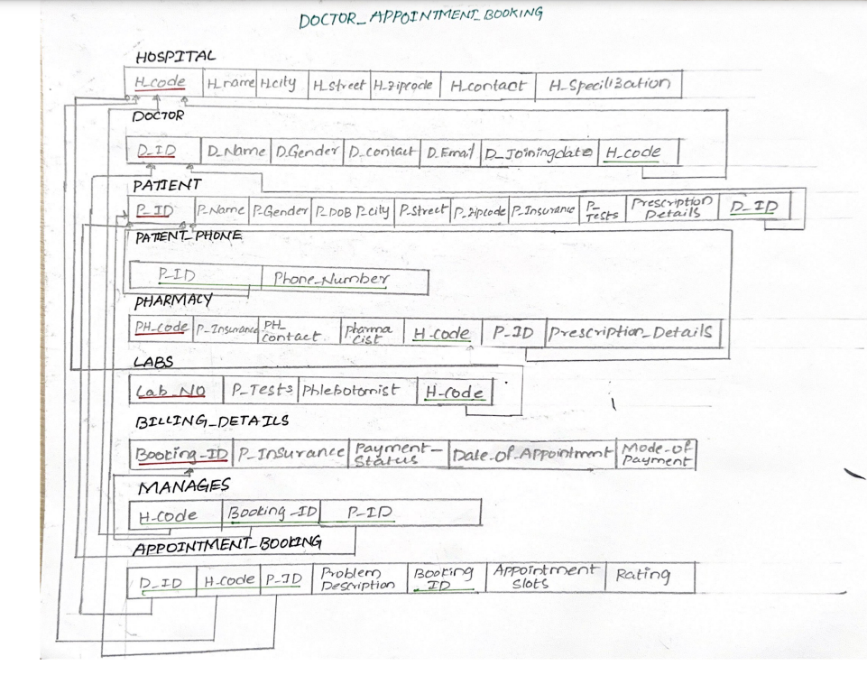
Relational Schema

Slide 6
Project Goal
We met most of the business goals, like:
The main Business goal is to reduce the waiting time of the patient.
Used to find the Booking ID's of patients who have partially paid, this helps for the hospital to track the transaction that they made.
Finding the data of the patients according to the age group.
Rating helps to choose the good doctor according to their health condition.

Slide 7
Project Takeaway
If done in a team, how did you manage the tasks and time?
It is a team project of 4 members, the main thing we focused is on communication and at the starting it was bit challenging to manage the time, eventually we have prioritized the important tasks and worked accordingly.
Which phase(s) of the project was (were) difficult and why?
We felt the phase 4 is bit time consuming than the other phases,
Tracking the data according to the business goals was bit challenging.

Slide 8
Project Takeaway
Are you happy with what you have developed?
Pretty much, the entire project is started from the scratch.
We have progressed independently by learning the concepts throughout the process.
Do you think this will add strength to your resume?
Yes, from this we learned how to implement a project with the team
What was your takeaway from the project that you think may help you in future?
In the any project we have to deal with the data in the backend. So, we have learnt the concepts with the help of SQL, and integration of data from backend to frontend.

Slide 9
Overall Feedback
Everything seems to be good and helped for the course
How can the project experience be improved?
The phases are well organized according to the modules that are covered in the class based on the real time scenario.
How can the course experience be improved?
The concepts that were taught in the class are practically implemented in the phases of the project, which helped uso focus on the things that are required for our learning.
We also learned to handle the large data like IMDB.
How can the test experience be improved?
The comprehensive exams helped to focus on the entire concepts that we learned in the course.

Slide 10
General
Any general feedback or thought that you want to share?
The course structure is well organized and interactive.
Can add more pop-quiz on SQL quires, so that we can learn how to manage the time to write one particular query.

Slide 11


Slide 12
Discussion

